Slide 1
Amazon Sales Data Analysis
By Rajashree Gavali

Slide 2
Data Source
The primary data is provided by Amazon, which is then pre-processed and collated by me.
The data has been cleaned using Excel and then analysed and presented with insights with the help of Tableau.

Slide 3
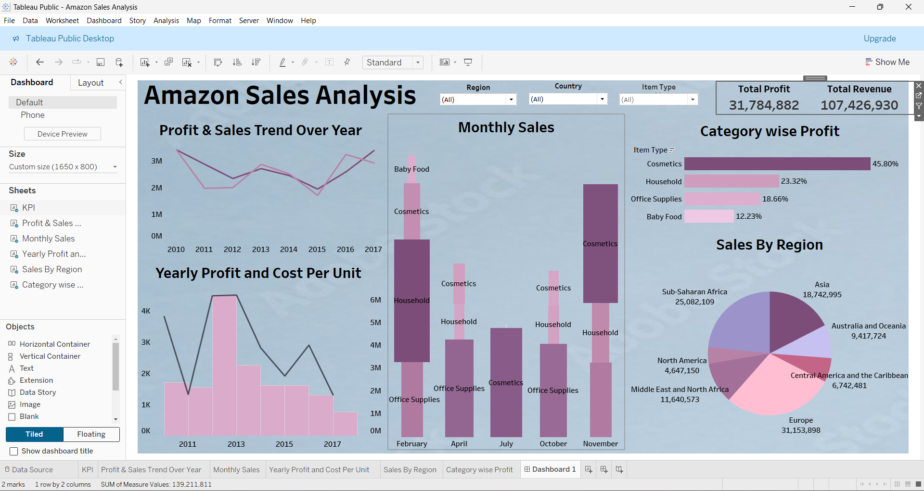
Sales By Region

Slide 4
Yearly Profit and Cost Per Unit

Slide 5
Profit And Sales Trend Over Year

Slide 6
Category Wise Profit

Slide 7
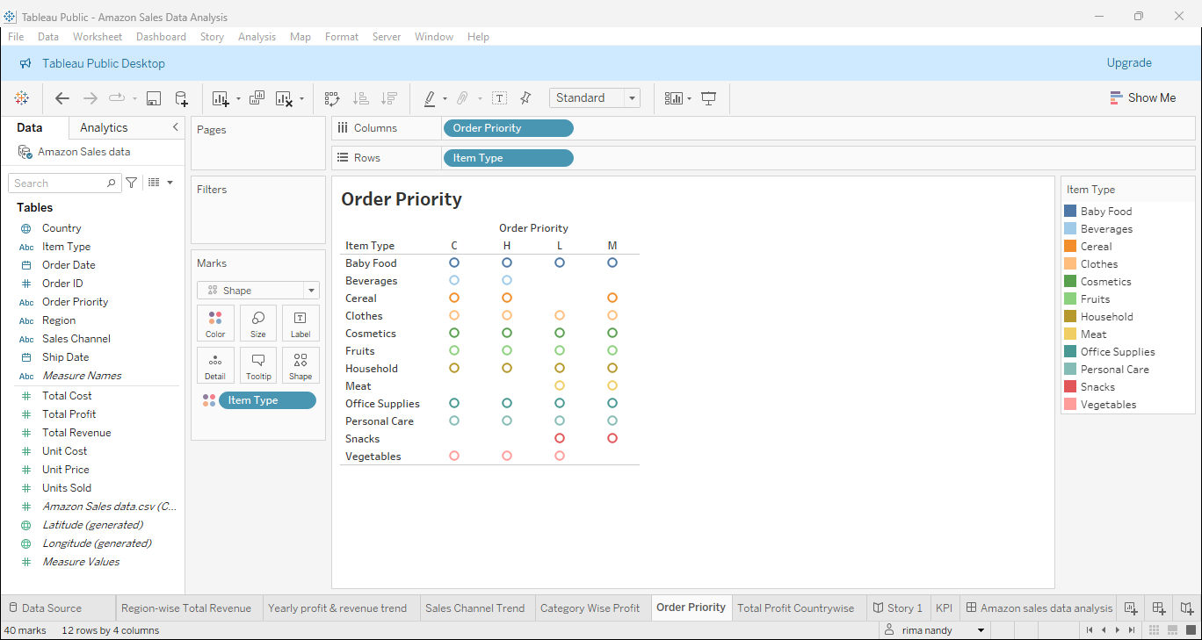
Order Priority in each Product type

Slide 8
Month-wise Total Sales

Slide 9
Amazon Sales Data Analysis
Through the analysis of Amazon Sales Data, the following points can be ascertained:
Region-wise Iceland has the highest revenue of sales followed by San Marino both of them are European countries.
Through yearly profit and revenue analysis, it can be said that 2015 is the most profitable year with the highest yearly revenue.
Category-wise, products like cosmetics, office supplies and household make up the largest profit share.
Priority-wise, baby food has the highest priority over all orders.
Country-wise, the Europe Region has the highest sales.
The highest sales occurred in February and November, during which cosmetics were sold the most.

Slide 10
Thank you

